Slide 1


პროგრამული უზრუნველყოფის ინჟინერია
ლექცია 6

Slide 2
Welcome!
Today:
Abstract Data Type
Invariants
Rep Invariant and Abstract Function

Slide 3
Terminology
Abstraction. Omitting or hiding low-level details with a simpler, higher-level idea.
Modularity. Dividing a system into components, each of which can be designed, implemented, tested, reasoned about, and reused separately from the rest of the system.
Encapsulation. Building walls around a module so that the module is responsible for its own internal behavior.
Information hiding. Hiding details of a module’s implementation from the rest of the system.
Separation of concerns. Making a feature the responsibility of a single module, rather than spreading it across multiple modules.
Notes:
Abstraction. Omitting or hiding low-level details with a simpler, higher-level idea.
Modularity. Dividing a system into components or modules, each of which can be designed, implemented, tested, reasoned about, and reused separately from the rest of the system.
Encapsulation. Building walls around a module (a hard shell or capsule) so that the module is responsible for its own internal behavior, and bugs in other parts of the system can’t damage its integrity.
Information hiding. Hiding details of a module’s implementation from the rest of the system, so that those details can be changed later without changing the rest of the system.
Separation of concerns. Making a feature (or “concern”) the responsibility of a single module, rather than spreading it across multiple modules.

Slide 4
Abstract Type Operations
Creators create new objects of the type.
Contstructors
Producers create new objects from old objects of the type.
The concat() method of String.
Observers take objects of the abstract type and return objects of a different type.
The size() method of List.
Mutators change objects.
The add() method of List.

Slide 5
Abstract Data Types
List type
creators: ArrayList and LinkedList constructors, Collections.singletonList
producers: Collections.unmodifiableList
observers: size, get
mutators: add, remove, addAll, Collections.sort

Slide 6
Abstract Data Types
String type
creators: String constructors
producers: concat, substring, toUpperCase
observers: length, charAt
mutators: none (it’s immutable)

Slide 7
Representation Independence
Use of an abstract type is independent of its representation!
Different representations of String

Slide 8
Invariant
Property of the ADT - ADTs preserve its own invariants
Example - Immutability
Tweets

Slide 9
Rep Invariant
The space of representation values
The space of abstract values
Implementor’s job to achieve the illusion of the abstract value space using the rep value space.

Slide 10
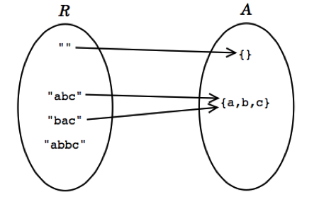
CharSet Example
public class CharSet {
private String s;
...
}
Notes:
Every abstract value is mapped to by some rep value
Some abstract values are mapped to by more than one rep value .
Not all rep values are mapped

Slide 11
Rep Invariant and Abstract Function
We can describe the relationship by:
1. An abstraction function that maps rep values to the abstract values they represent:
AF : R → A
2. A rep invariant that maps rep values to booleans:
RI : R → boolean
For a rep value r , RI(r) is true if and only if r is mapped by AF .
The abstract value space alone doesn’t determine AF or RI
Notes:
abstraction function is surjective (also called onto ), not necessarily injective ( one-to-one ) and therefore not necessarily bijective, and often partial.

Slide 12
CharSet Example
public class CharSet {
private String s;
// Rep invariant:
// s contains no repeated characters
// Abstraction Function:
// represents the set of characters found in s
...
}

Slide 13
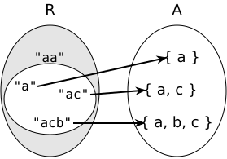
CharSet Example

Slide 14
CharSet Example
public class CharSet {
private String s;
// Rep invariant:
// s[0] <= s[1] <= ... <= s[s.length()-1]
// Abstraction Function:
// represents the set of characters found in s
...
}

Slide 15
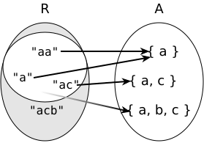
CharSet Example

Slide 16
CharSet Example
public class CharSet {
private String s;
// Rep invariant:
// s.length is even
// s[0] <= s[1] <= ... <= s[s.length()-1]
// Abstraction Function:
// represents the union of the ranges
// {s[i]...s[i+1]} for each adjacent pair of characters
// in s
...
}

Slide 17
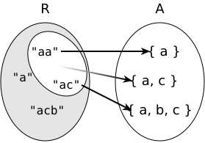
CharSet Example

Slide 18
Rep Invariant and Abstract Function
The abstract value space alone doesn’t determine AF or RI
It’s less obvious why the choice of both spaces doesn’t determine AF and RI.
The essential point is that designing an abstract type means not only choosing the two spaces – the abstract value space for the specification and the rep value space for the implementation – but also deciding what rep values to use and how to interpret them .

Slide 19
Some Tips
Use no null values in rep
Use checkRep() method
Document AF and RI!
Think about safety from rep exposure!
Prove the safety!

Slide 20
Establish Invariants
An invariant is a property that is true for the entire program
creators and producers must establish the invariant for new object instances;
mutators and observers must preserve the invariant
no representation exposure should occur

